Slide 1
Prudential Life Insurance Data Assessment
GROUP 4
Yuan Li
Vineeth Kashyap
Ninad Gadre
Isha Chawla

Slide 2
Project Details :
Introduction –
Prudential, is one of the largest issuers of life insurance in the United States. What they are trying to accomplish is better understand the predictive capabilities of data and determine what are the key factors that affect Life Insurance and how can they make this extensive process quicker for the customers.
Data Description –
Prudential has provided hundreds of variables describing the attributes of life insurance applicants. We have to identify the Response variable which is a measure of Risk and has 8 levels.
Different Type of Data –
1. Categorical Variables – Variables that have a finite or distinct number of groups. An example of categorical variable is gender.
2. Continuous Variables- Variables whose values lie between a range(max,min).
3. Discrete Variables- A numeric value , for example the count of patients that come in the hospital on any given day.

Slide 3
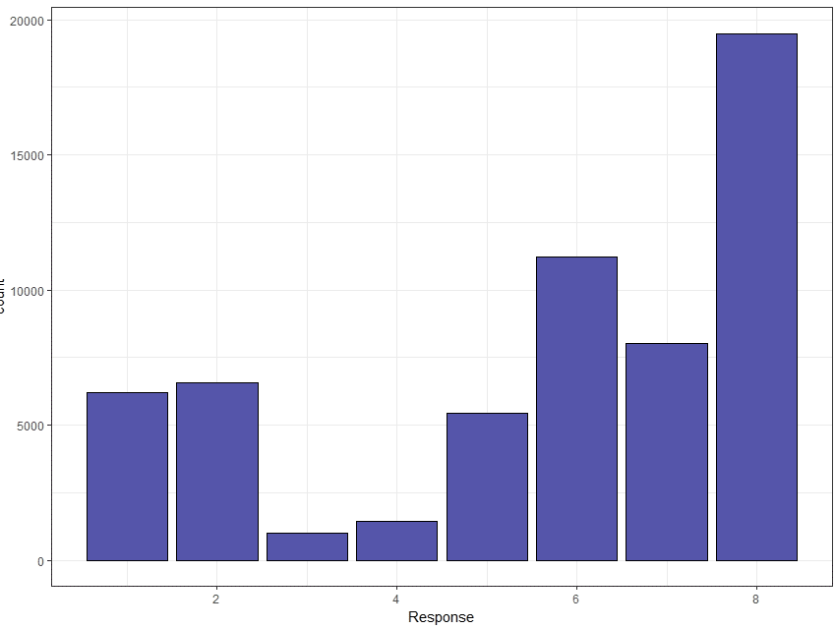
Data and Preprocessing:
Our dataset had two files : Train and Test. We have a response variable in Train and we need to predict the Response Variable for the Test data file.
We will use our Train file and implement Machine Learning Algorithms to find a predictive model.
Figure showing the frequency of each Response value in Train dataset.

Slide 4
Pre-processing :
Pre-processing forms a major part of the data prediction which is done over a number of stages :
Data Cleaning : We found our data had columns that had over 70% values as null, which makes it hard for us to do analysis and implement any Machine Learning Algorithms.
Data Imputation : After removing, the columns with majority of null values, we encounter that some columns still have missing values and for these cases we use mean and median to miss the filling data.
Data Standardization : We were lucky, because the data was already standardized in this case.
Manipulating Categorical Variables : We use 1:C coding or one hot encoding, to remove the categorization and make every instance of each category a separate column for the Machine Learning Algorithm to do a better job.
Picking a ML Algorithm : We used 4 algorithms to predict the same thing, Linear Regression, Decision Tree, SVM and XGBoost.
Finding the algorithm that fits the data best.

Slide 5
Overview of Approach:
Data Cleaning
Data Imputation
Data Standardization
One Hot Encoding
Linear Regression
Finding the algorithm that gives us the best accuracy and has least error/risk associated with it.
Decision Tree
Clean Dataset
SVM
XGBoost

Slide 6
Linear Regression :
Reducing Dimension
– PCA: Principal component analysis (Simple but powerful!)
Mostly used as a tool in exploratory data analysis and for making predictive models.
Used to visualize genetic distance and relatedness between populations.
Can be done by eigenvalue decomposition of a data covariance (or correlation) matrix or singular value decomposition of a data matrix,
Use an orthogonal transformation to convert a set of observations of possibly correlated variables into a set of values of linearly uncorrelated variables called principal components.
An orthogonal linear transformation that transforms the data to a new coordinate system such that the greatest variance by some projection of the data comes to lie on the first coordinate (called the first principal component), the second greatest variance on the second coordinate, etc.

Slide 7
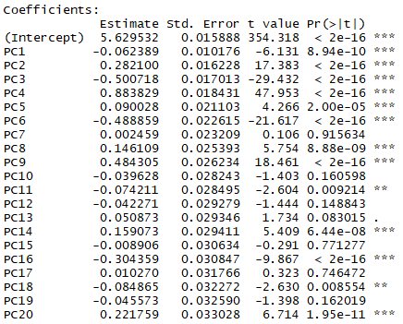
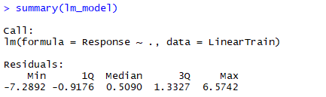

Linear Regression :
Appending response variable and dividing the dataset
(For test!)
Applying Linear Regression
(0 ‘***’ 0.001 ‘**’ 0.01 ‘*’ 0.05 ‘.’ 0.1 ‘ ’ 1)

Slide 8

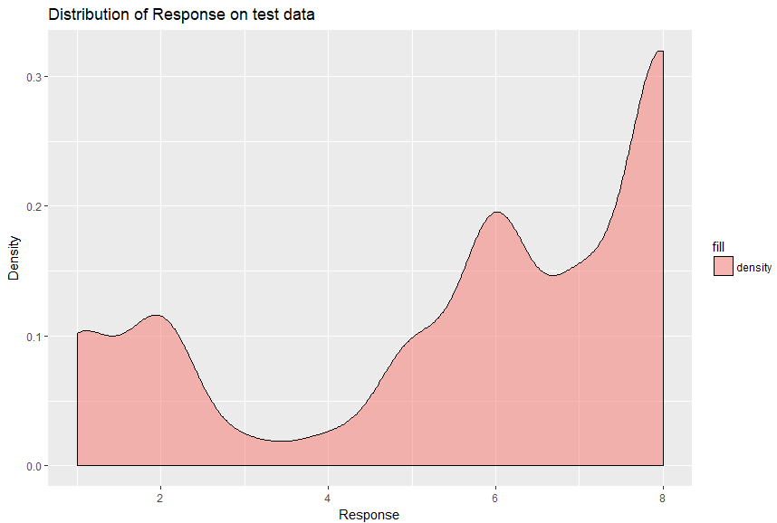
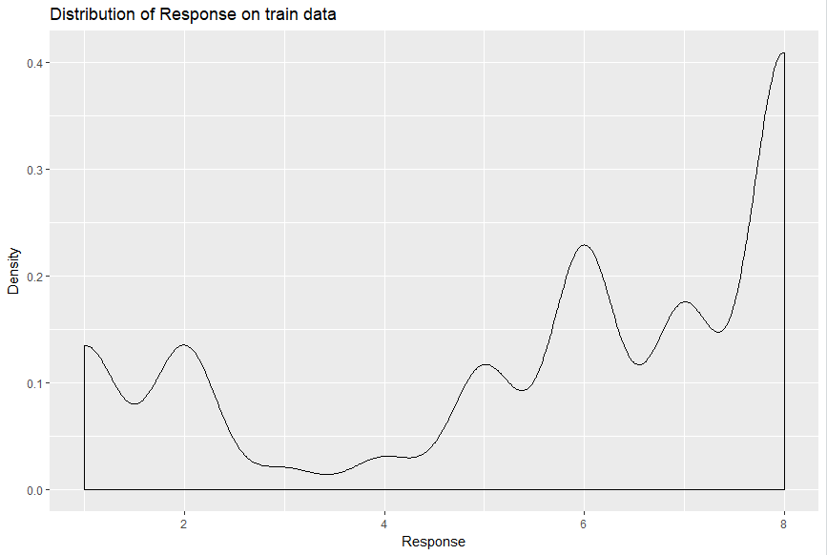
Linear Regression :
Predicting response variable and calculating accuracy
Plotting response distribution for test and train

Slide 9
SVM Regression :
Steps involved in SVM Regression are:
The data obtained after preprocessing was fed into RStudio.
Using Random Forest, the insignificant columns were eliminated.
Parameter tuning of SVM was done to obtain the best cost and gamma values.
The SVM model was built using the obtained values.
Predicted the response values for the test dataset.
Accuracy and the Root Mean Square Error were calculated based on the above obtained response values.

Slide 10

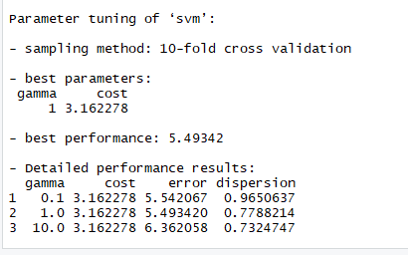
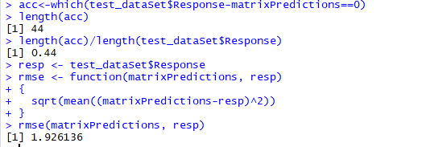
SVM Regression :
Using random forest, we determined the top 20 most significant columns of the whole clean dataset.
These columns were used to tune the svm model to obtain the best performance parameters: The Cost and Gamma values.
Cost : 3.162278, Gamma: 1.0.
Using these values, the SVM model was trained and tested to obtain:
Accuracy: 44%
RMSE: 1.926136
Screenshot of the prediction on test data

Slide 11
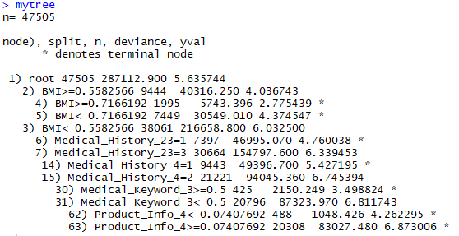
Decision Tree :
Steps performed in application of decision tree regression on prudential dataset:
1. Fetch the preprocessed data and split it as test data and train data
2. Using rpart() train the model on train data
3. Render the plots and summary of the model
4. Display the cross validation plots and confusion matrix
5. Calculate the model accuracy with the actual and predicted values

Slide 12
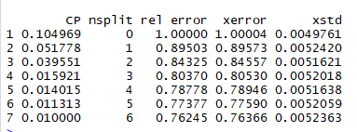
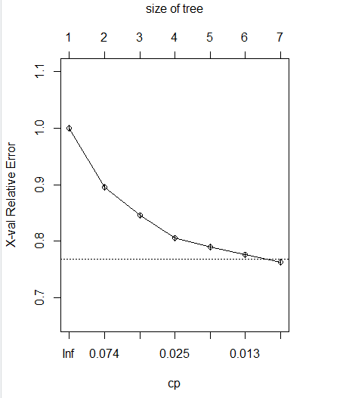

Decision Tree :
CP Values

Slide 13
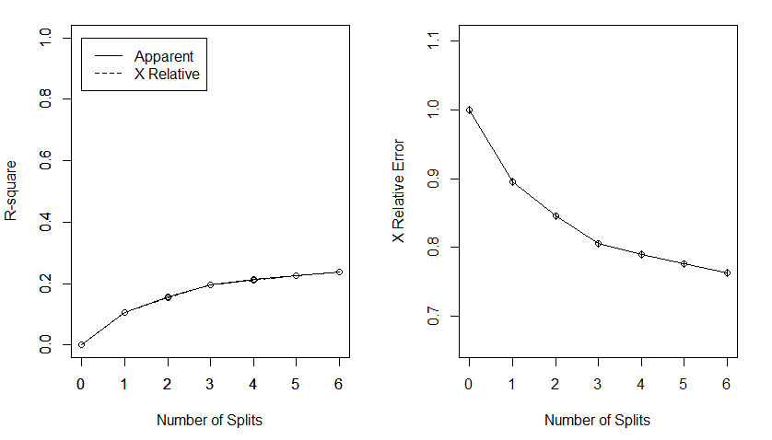

Decision Tree :

Slide 14
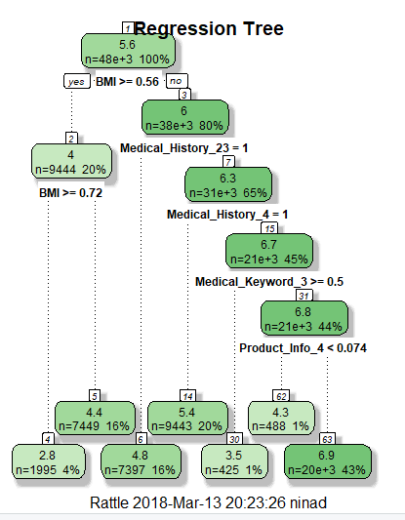
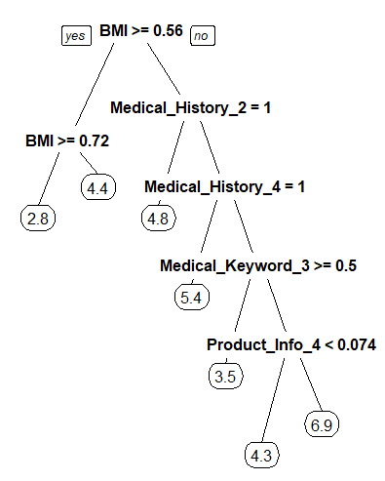
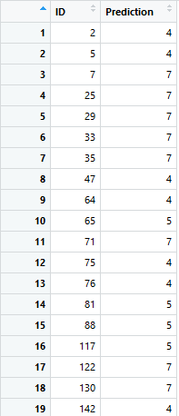
Decision Tree :
Splitting of Decision Tree based on Entropy and Information Gain Calculation
Screenshot of Prediction Data

Slide 15
XGBoost / Extreme Gradient Boosting :
XGBoost is an ensemble method that uses a couple of weak predictors and brings them together to form a model that has high accuracy and can predict the values better than a singular decision tree.
We use the xgboost function to train our data and after every iteration we check the value of the evaluation metric.
We also use xgb.cv to cross validate our findings and use RMSE and MAE as the evaluations metrics.
Parameter Tuning in XGBoost:
We have 3 kinds of parameters in XGBoost:
General Parameters | Tree Booster Parameters | Learning Task Parameters
Booster- gbtree used tree based functions and gblinear uses linear function | Eta or Shrinkage Parameter: Used to make sure the model does not overfit, After each iteration eta shrinks the feature weights. Lambda – L2 Regularization Term Alpha – L1 Regularization Term | Objective : What the algorithm is supposed to do (reg:linear, reg:logistic) Evaluation metric: A way to evaluate the model. (RMSE, MAE)

Slide 16
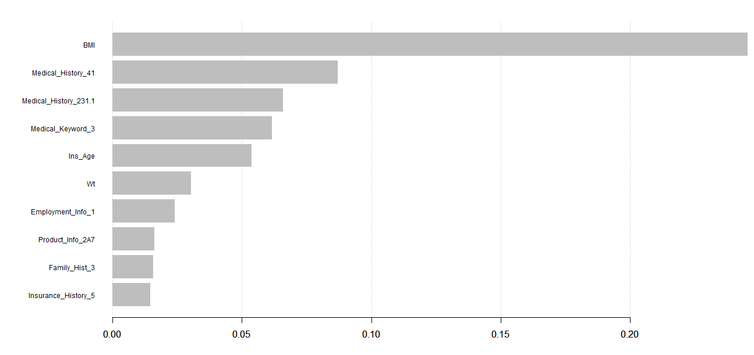
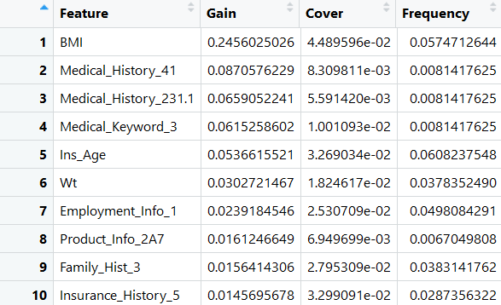
XGBoost :
XGBoost has a data structure Information Matrix, which has 3 features:
Information Gain – contribution of each feature to the model, the higher the value, the more the contribution.
Cover- How many times a feature occurs in the model and is used to make a decision.
Frequency- Relative number of times a feature occurs in the model.
Information Gain Metrics for 10 variables
Information Matrix with attributes like Gain,Cover,Frequency

Slide 17
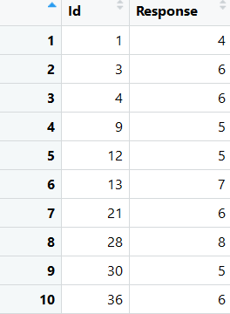
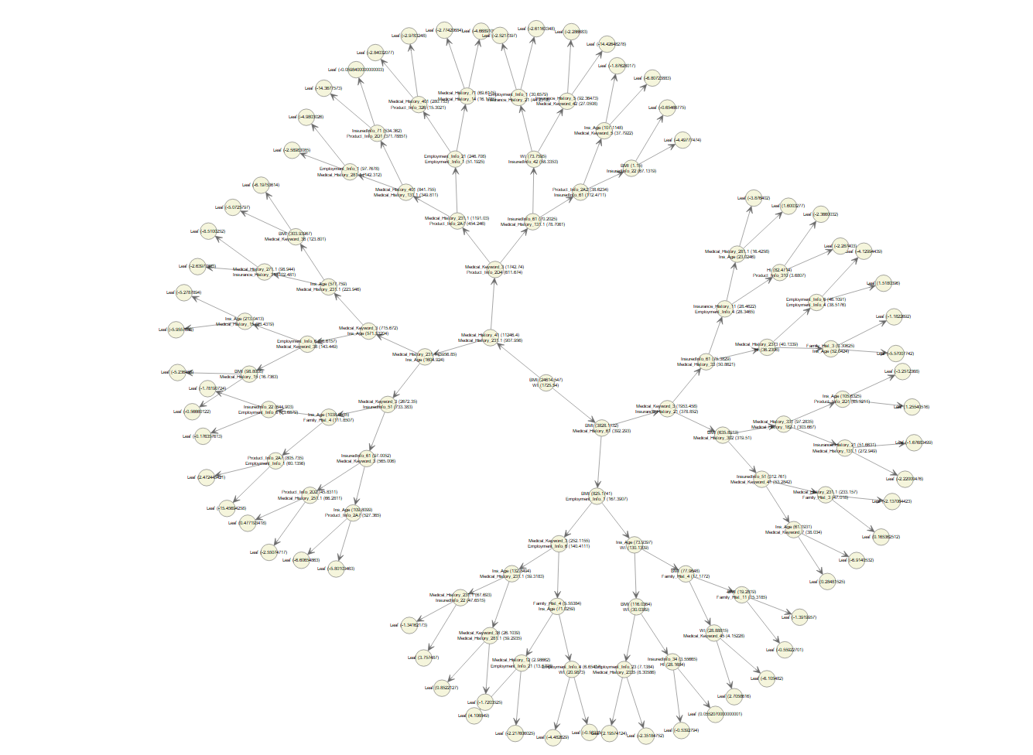
XGBoost :
Screenshot of the prediction on test data
Xgb.multi.tree gives us a glimpse of the ensemble with multiple trees

Slide 18
Conclusion :
Type of Regression | RMSE Value
Linear Regression | 1.985102
SVM | 1.926136
Decision Tree | 2.146986
XGBoost | 1.712073
As we look at the RMSE values for all the models we can see that XGBoost gives us the lowest RMSE value and is the best model that should be used to determine the ordinal variable Response.
RMSE values of different models

Slide 19
Future Solutions/Use Cases:
Use of Lasso and Elastic Net to do Dimension Reduction and get the most important variables and try using our ML models on the subset of variables and notice the change in accuracy.
Factor Analysis- A lot of categorical variables in the dataset have levels that do not occur frequently and probably removing those can give us a more cleaner dataset to work on.
Using a agglomerative approach or bottom up method like Hierarchical Clustering to train the data.

Slide 20
Thank You

